Slide 1
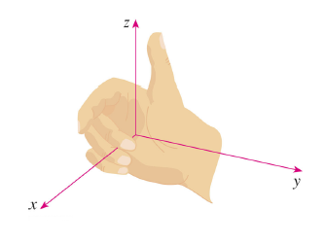
Right hand Rule for 3D axis

Slide 2
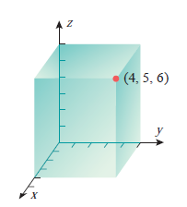
Point in 3D P(x, y, z)
e.g. (4,5,6)

Slide 5
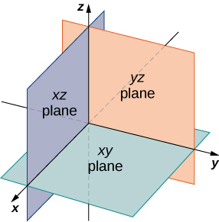
Coordinate Planes

Slide 6
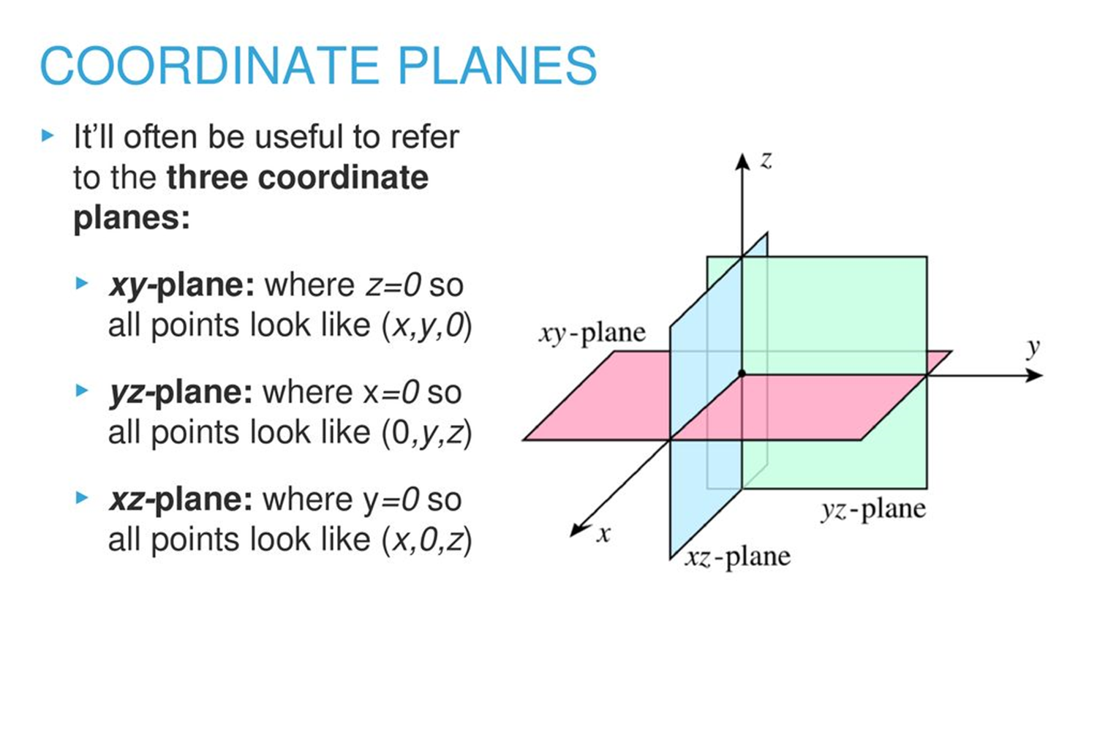

Slide 7
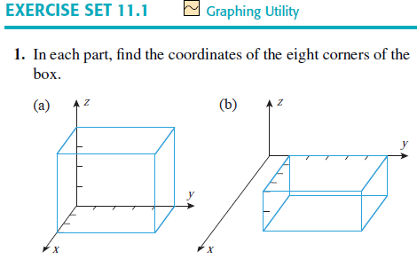

Slide 8
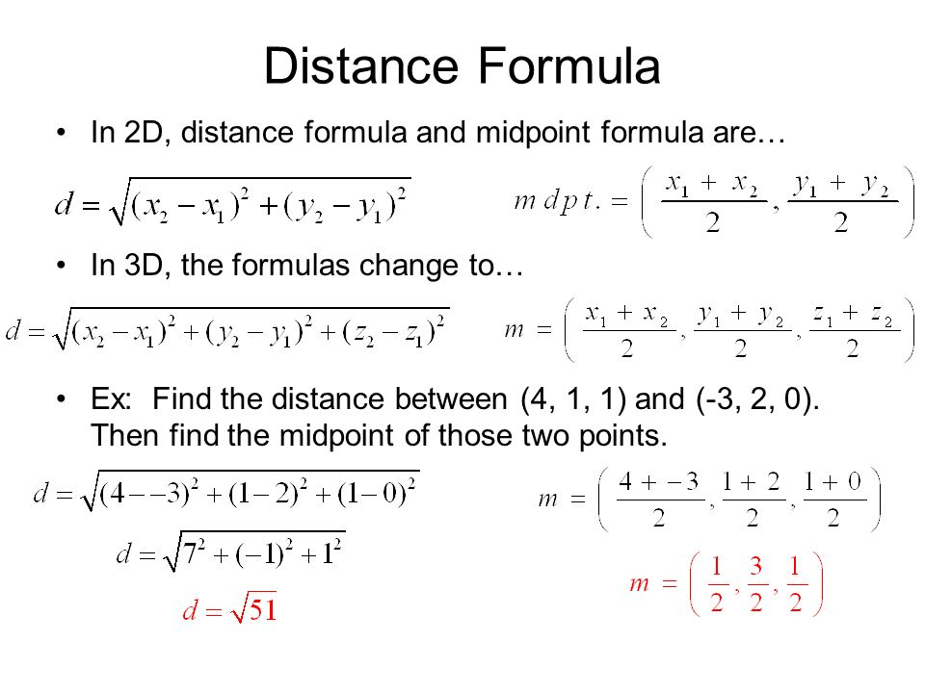

Slide 9
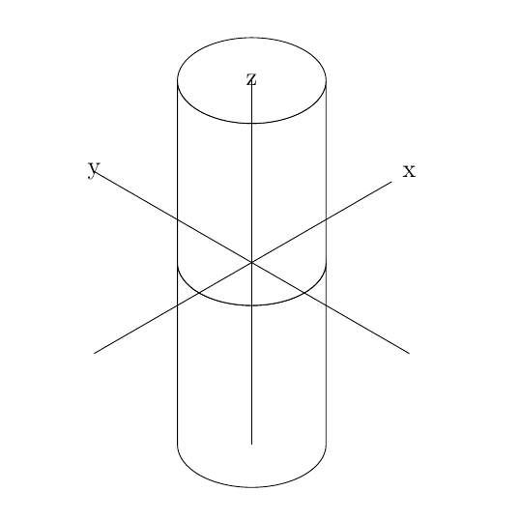

Slide 10
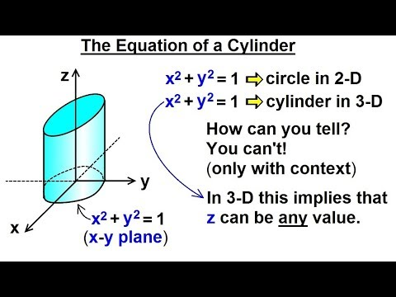

Slide 11
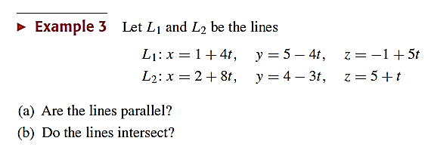
(b) Solution
Let L1 and L2 meet at same point (x_{o} ,y_{o} ,z_{o})
1+ 4t = 2 + 8t → t =-1/4
5 - 4t = 4 - 3t → t = 1
-1+5t = 5 + t → t = 1
Since from above equations we have different values of t therefore line do not meet at any point

Slide 12
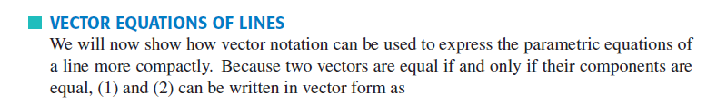
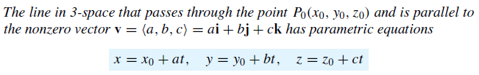
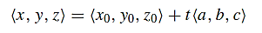
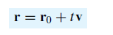

Slide 13
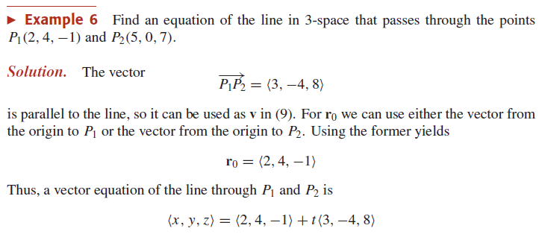

Slide 14

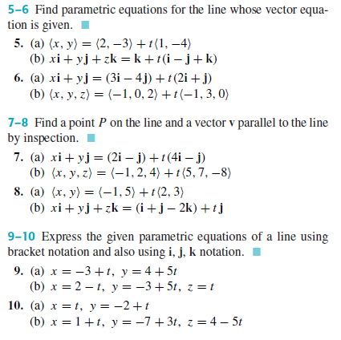

Slide 15
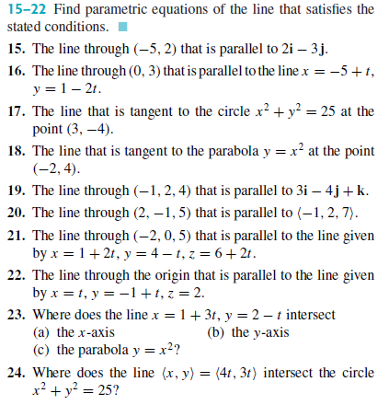

Slide 16
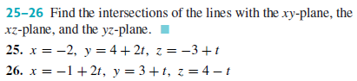
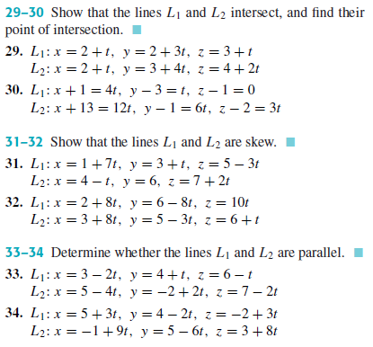

Slide 17
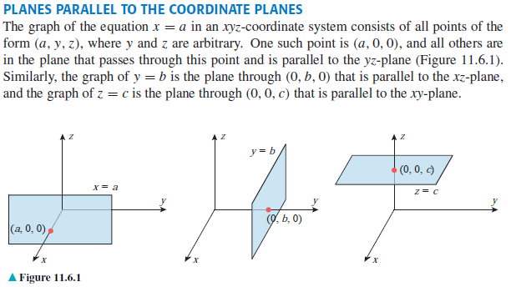

Slide 18
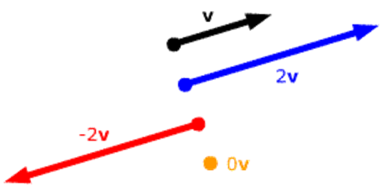
Parallel Vectors
Two vectors are parallel if these are scalar multiple
Let V₁ = <-1,0,4> and V₂ = <2,0,-8>
V₁ and V₂ are parallel vectors because they are scalar multiple
V₂ = -2 V₁
< 1, 5, -3>
< 2,10, -6>
<-1, -5, 3>
< 4, 20, -12>

Slide 19
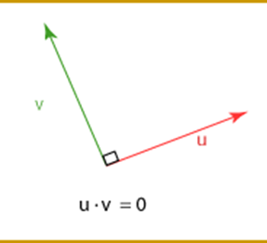
Perpendicular Vectors
Two vectors are perpendicular if their dot product is equal to zero.
Let V₁ = <-2,0,4> and V₂ = <2,1,1>
V₁ and V₂ are perpendicular to each other because their dot product
equals to zero.
V₁ . V₂ = <-2,0,4> . <2,1,1>
V₁ . V₂ = (-2)(2)+(0)(1)+(4)(1)
V₁ . V₂ = -4 + 0 + 4
V₁ . V₂ = 0

Slide 20
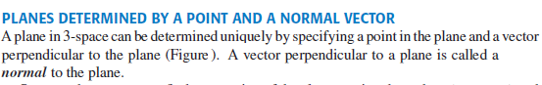
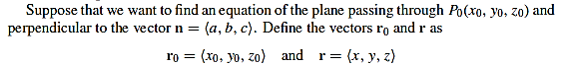
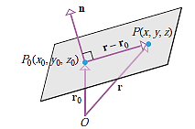
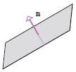

Slide 21
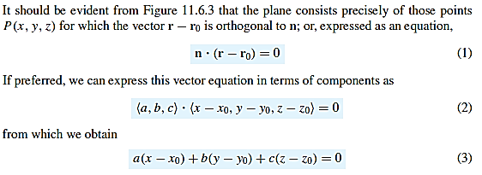
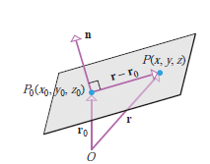

Slide 22
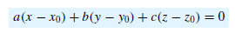
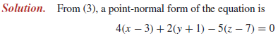

Slide 23
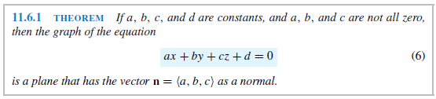
Example: The plane of equation x+2y-z-18=0 has normal vector
n= <1, 2, -1>

Slide 24
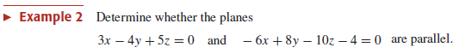
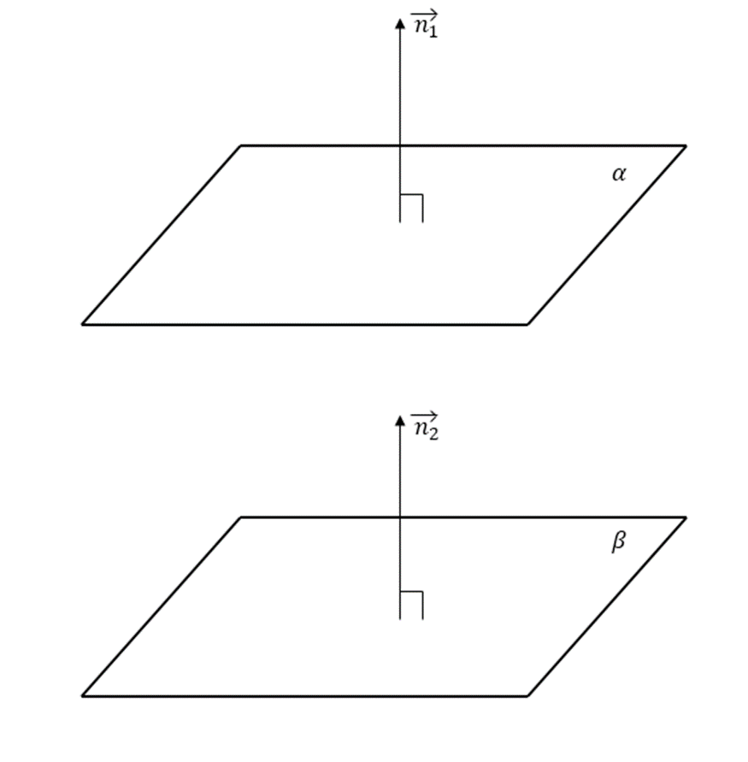

Slide 25
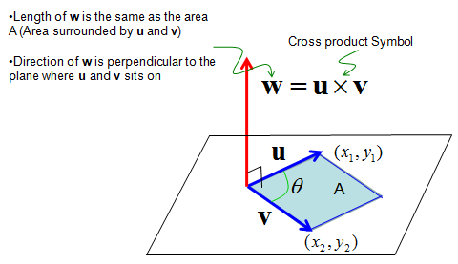
Cross product of vectors

Slide 26
Activity

Slide 27
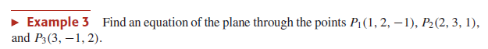
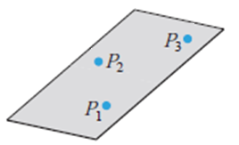
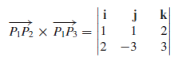
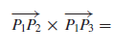
P₁P₂
P₁P₂
[ (1)(3) –(2)(-3) ] i – [ (1)(3)-(2)(2)] j + [(1)(-3)-(1)(2)] k
n=<9, 1, -5>

Slide 28
Activity

Slide 29
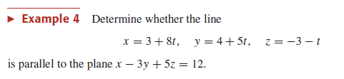
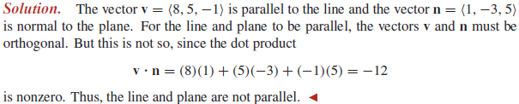
If vector of line and normal vector of plane are
perpendicular then line and plane are parallel.

Slide 30
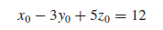
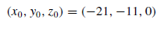
Substitute
Substitute in parametric equation of line.

Slide 31
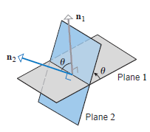
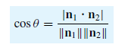
Angle between planes

Slide 32
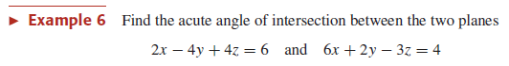
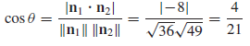
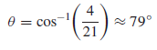

Slide 33
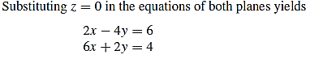
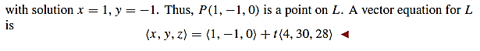
V is a vector parallel to line or V is vector on line,
If V is perpendicular to z axis then line will never cut xy-plane.
<0,0,1> is a unit vector on z axis
If it is perpendicular to z-axis, then line intersect xz-plane or yz-plane.
V is not perpendicular to z axis therefore line will cut xy-plane.
At xy-plane, z=0,

Slide 34
Activity

Slide 35
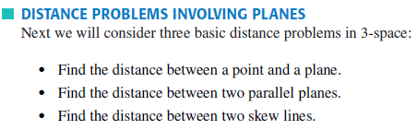

Slide 36
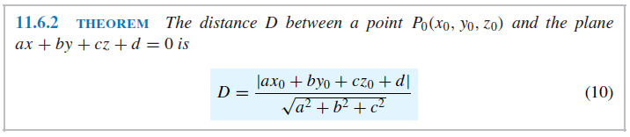


Slide 37



Slide 38




Slide 39



Slide 40



Slide 42

Quadratic surface

Slide 43


Slide 44


Slide 45


Slide 46



Slide 47



Slide 48



Slide 49


Slide 50


Slide 51



Slide 52




